Slide 1
Early Indicators of Covid 19 Updates in 14 States of United States
----Analysis on CDC Covid 19 data, Project 1-Team 3
Alhousseiny Pam; Carr Makhi And Parmeet Kaur Arora

Slide 2
Agenda
Predicting and diagnosing illnesses
Improving patient safety
Reducing time to diagnosis
Increasing our understanding of disease risks and causes
Developing stronger prevention strategies

Slide 3
COVID-19 Hospitalizations
COVID-NET is a population-based surveillance system
It is active collection, analysis, and interpretation of data on a population in a specified geographic area
Tracking COVID-19-associated hospitalization rates helps public health professionals understand trends in virus circulation, estimate disease burden, and respond to outbreaks
Hospitalization rates are updated weekly on the COVID-NET
Allows CDC to better understand COVID-19-associated hospitalization trends and determine who is most at risk.

Slide 4
Purpose of our analysis​
Using data set found on CDC called COVID 19 data tracker
We will be going through the folowing factors related to COVID-19 deaths
The Factors are State, Season, WeekendDate, AgeCategory, Sex, Race,Type, WeeklyRate, and CumulativeRate

Slide 5
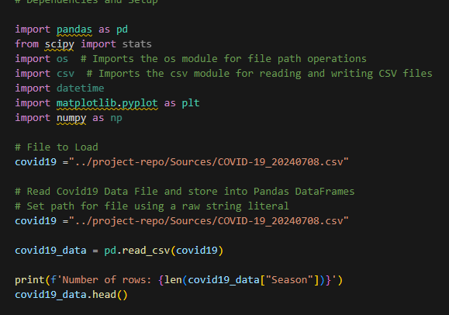
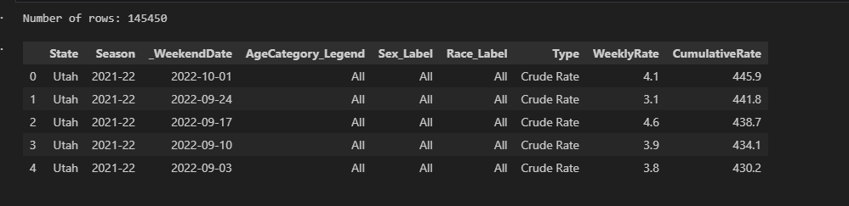
DATASET

Slide 6
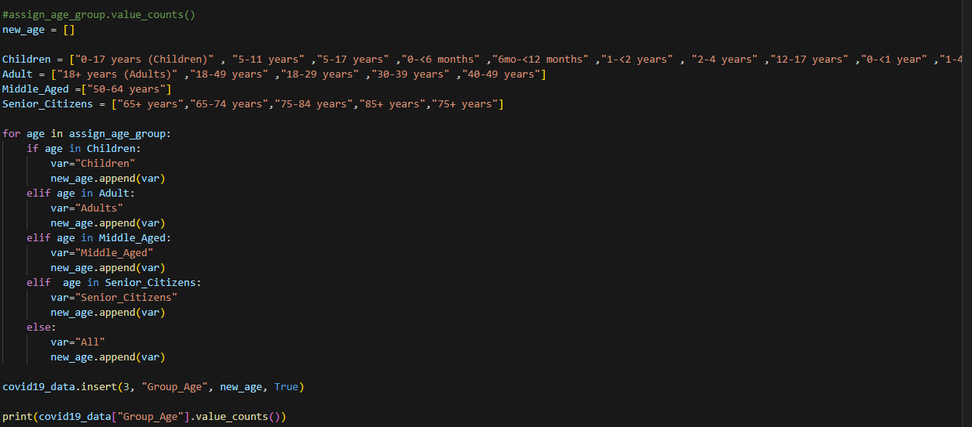
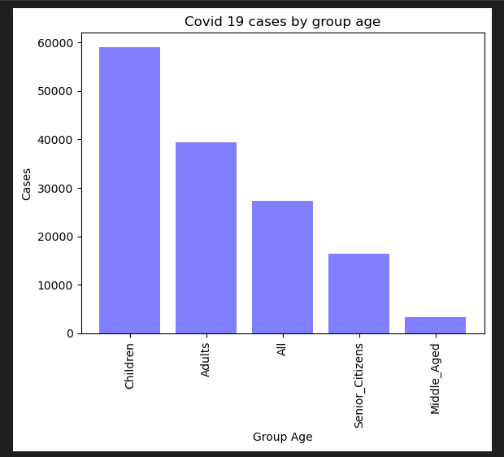
DATA CLEANING PROCESS
Our data was provided by the CDC in the form of a CSV file​
We put data into dataframes
Created new groups for Age the data into different age demographics ​

Slide 7
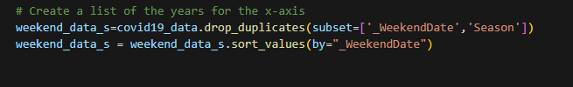
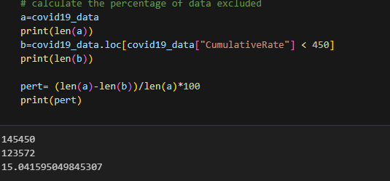
DATA CLEANING PROCESS Cont...
Dropped the duplicate data ​
Exclusion of about 15% to generate Box plots

Slide 8
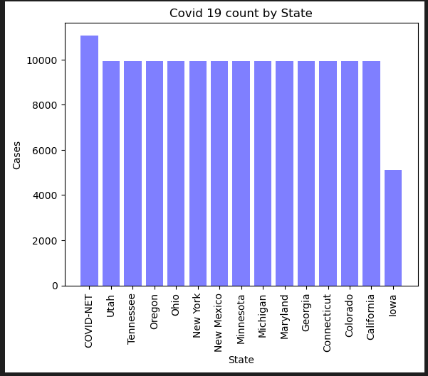
Participating States
Participating States for covid 19 cases had similar cases except Iowa with lower cases
COVID-NET collects surveillance data on laboratory-confirmed, COVID-19-associated hospitalizations among children and adults
Data are collected and reported from a network of sites in acute-care hospitals across 98 counties in 13 states.

Slide 9
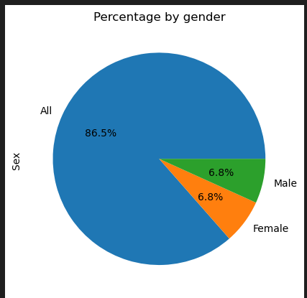
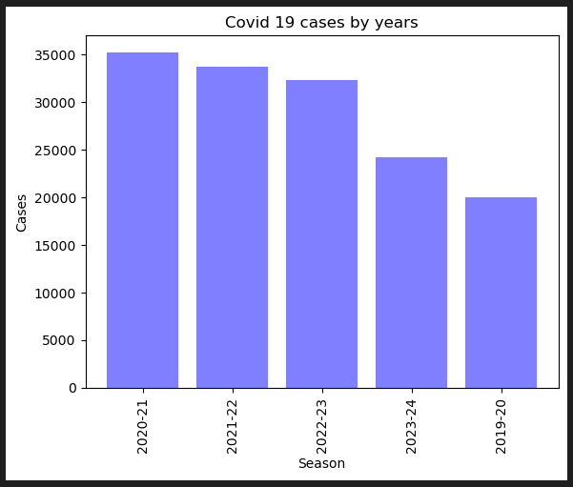
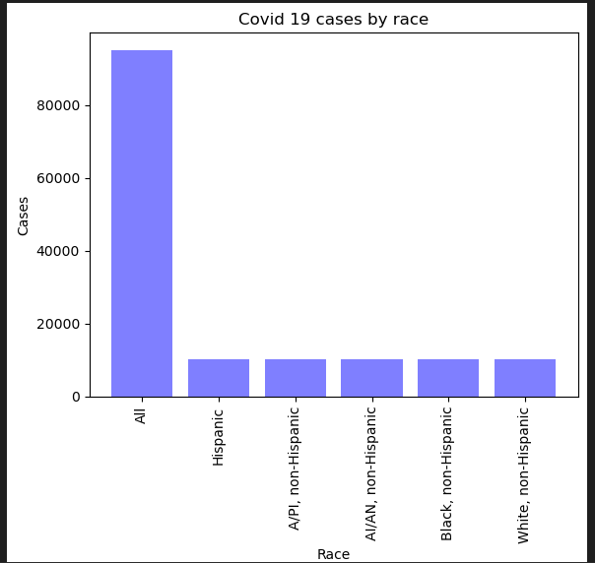
Cases by Season, Race and Gender

Slide 10
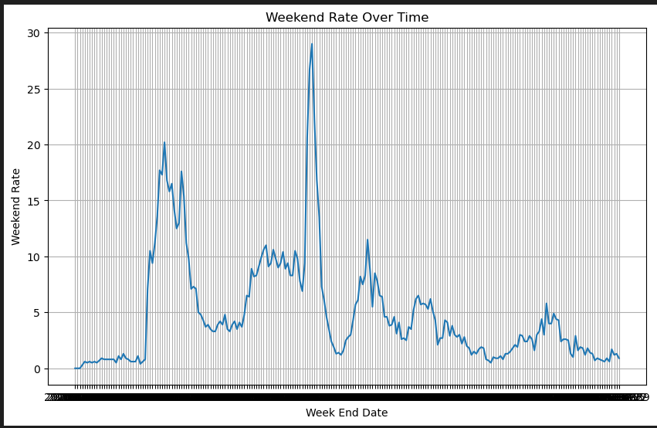
Line graph to show impact by Time
The line graph between Weekend date and weekly rate confirmed the highest cases in year 2020-21
2019 2020 2021 2022 2023 2024

Slide 11
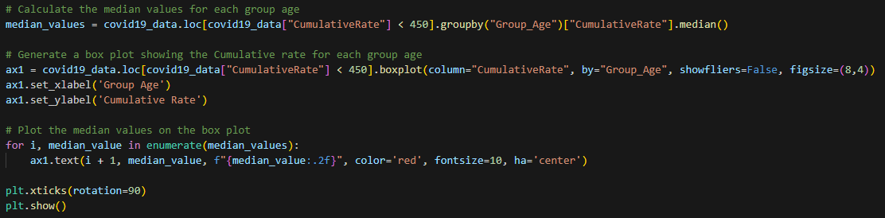
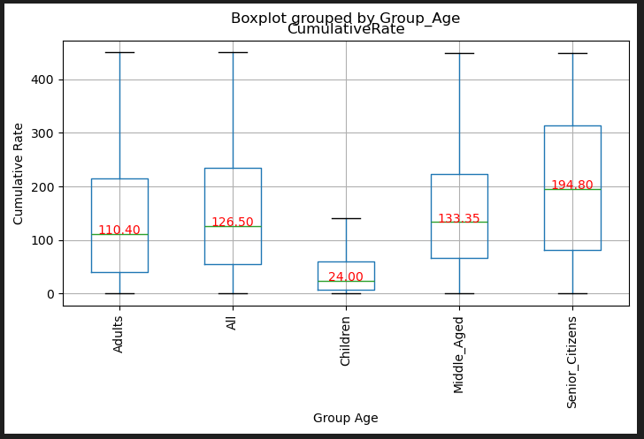
Boxplots and Median Values Calculated

Slide 12
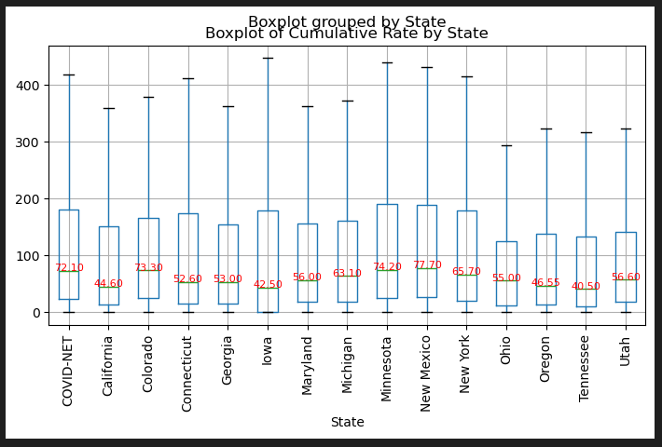
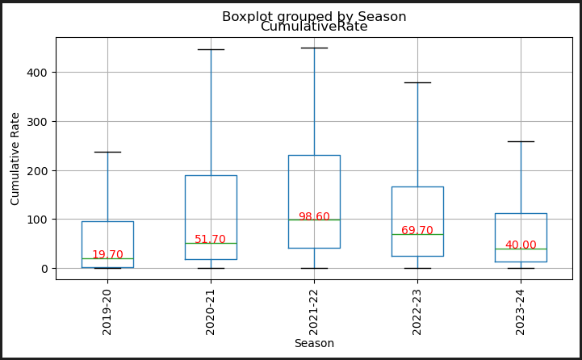
Boxplots Cont..

Slide 13
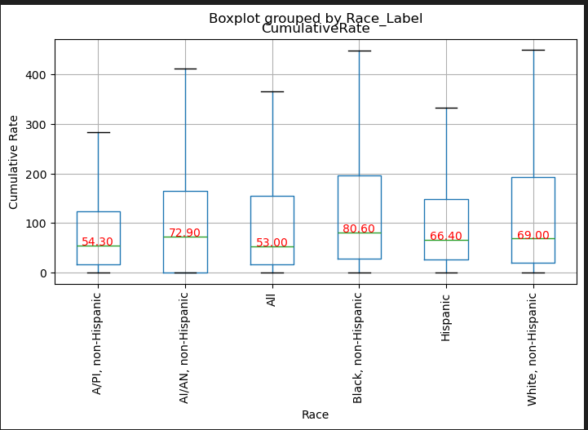
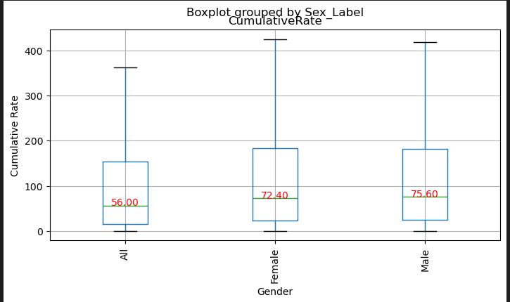
Boxplots Cont…

Slide 14
LIMITATIONS
The limitation is data is more crude type
"crude rate" refers to a basic calculation of a rate without any adjustments or standardization for factors such as age, sex, or other variables that may affect the outcome being measured.,Crude rates are often used as a starting point to provide a general overview of a particular health outcome or event within a population. They are simple calculations that divide the number of events (such as cases of a disease) by the total population at risk, usually expressed per a specific unit of time (e.g., per week, per year).

Slide 15
Summary
In Conclusion, this data analysis provides insights for collecting demographic and more detailed clinical information, including underlying conditions, that allows to better understand COVID-19-associated hospitalization trends and determine who is most at risk.

Slide 16

Thank you

